Slide 1
Confidence Interval

Slide 2
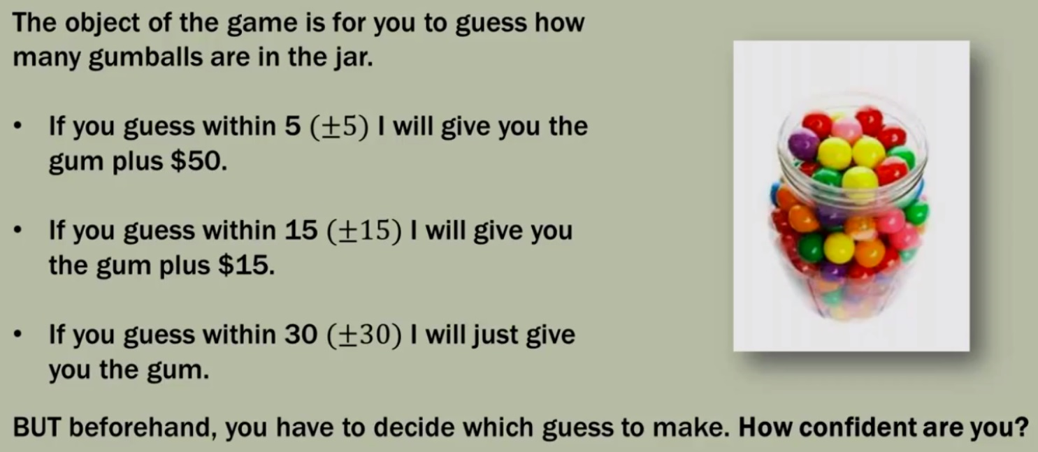
How confident are you to guess certain things?

Slide 3
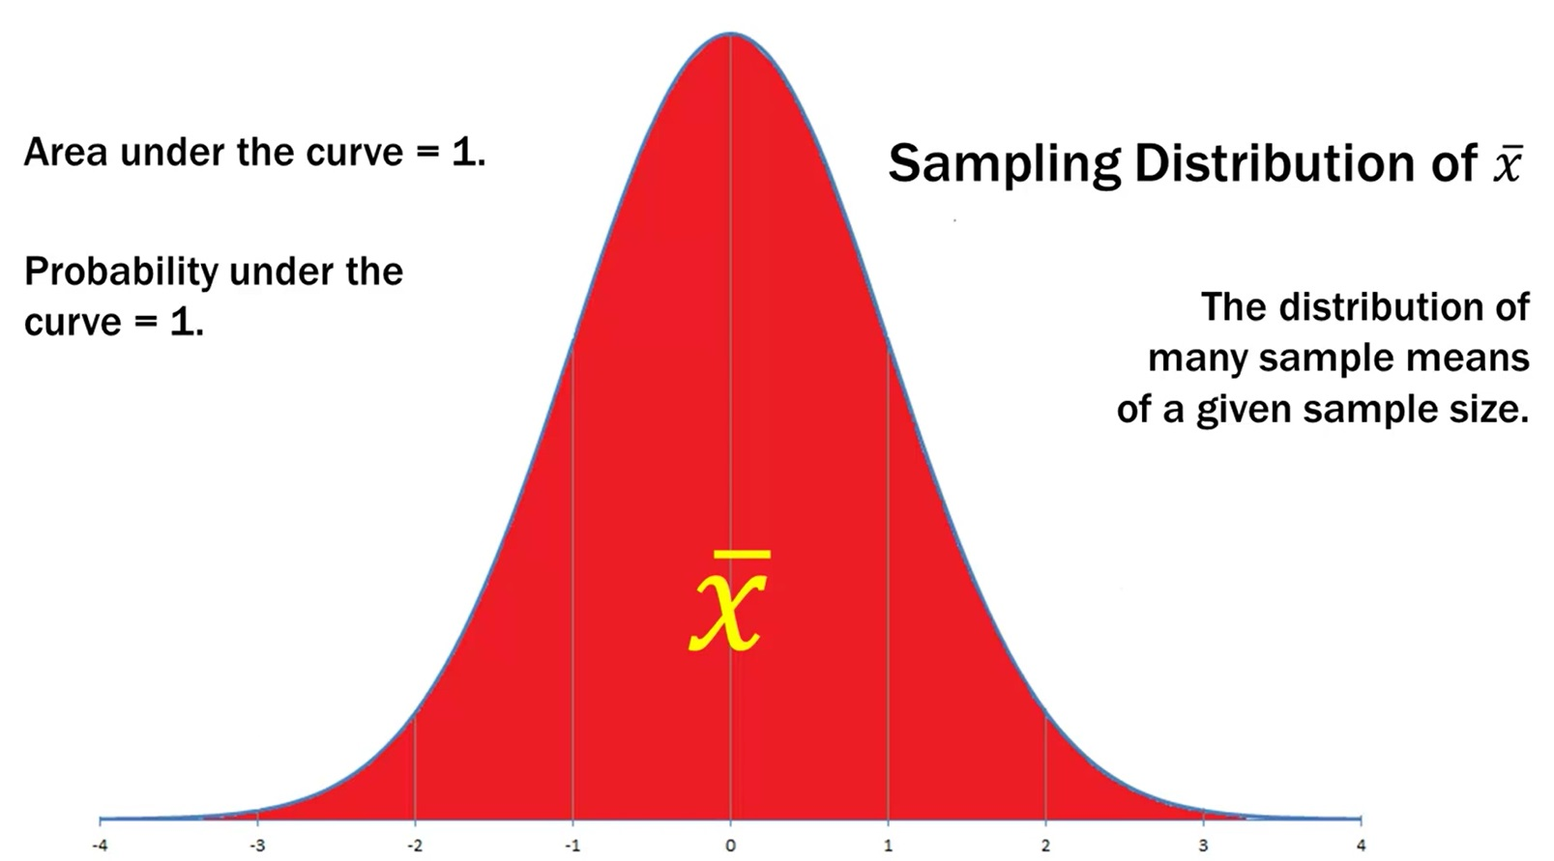
The Standard Normal Curve

Slide 4
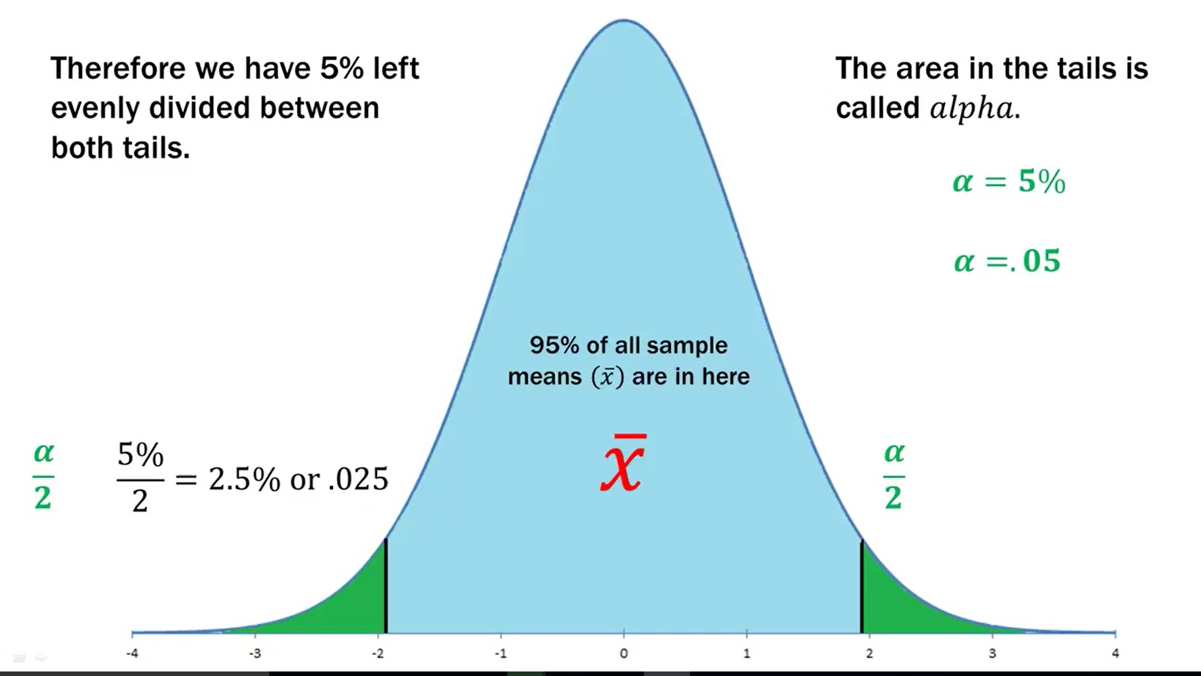
95% probability interval

Slide 5
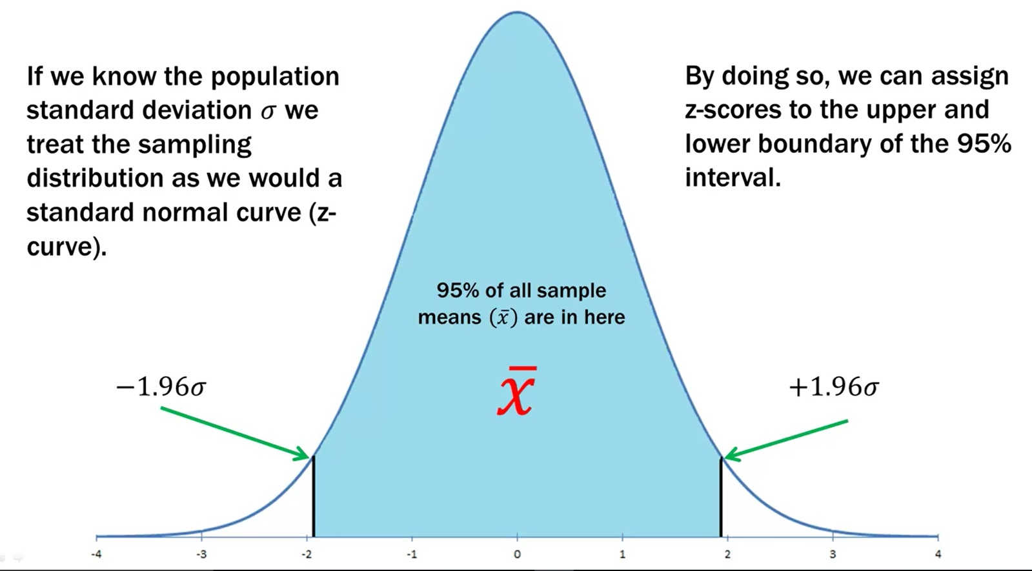
95% probability interval

Slide 6
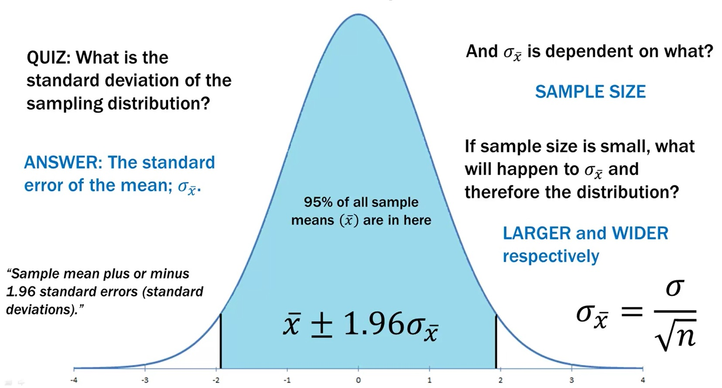
Contd….

Slide 7
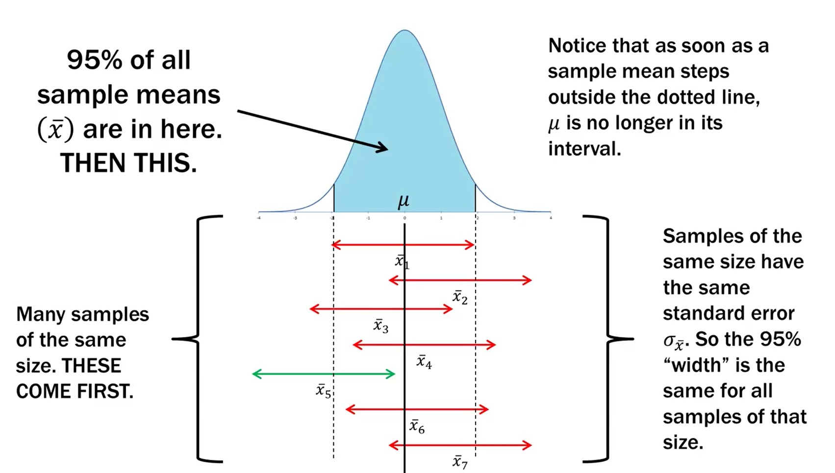
Sampling distribution and confidence interval

Slide 8
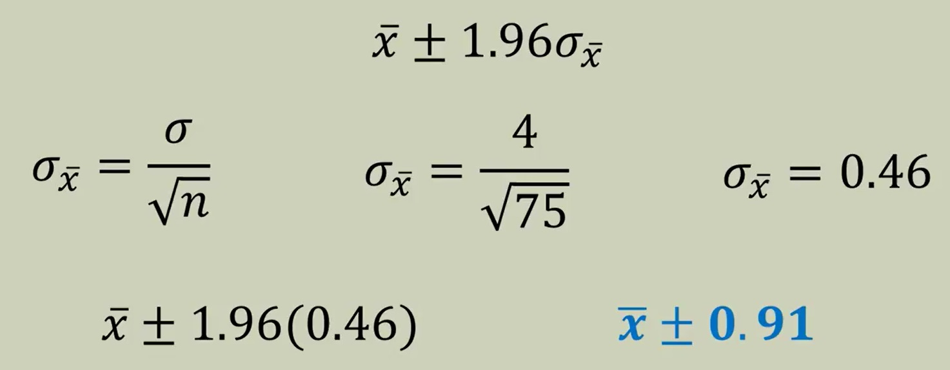
Exercise 1: To estimate the mean amount spent per customer at Aum Zam for Coffee at Lobesa (fictitious example), data was collected for 75 customers. We are to assume to population standard deviation (σ) as Nu. 4.
At 95% Confidence interval, what is the margin of error?
If the sample mean (the mean amount spent by customers) is Nu. 20, what is the 95% confidence interval for the population (population mean)?
Formula

Slide 9
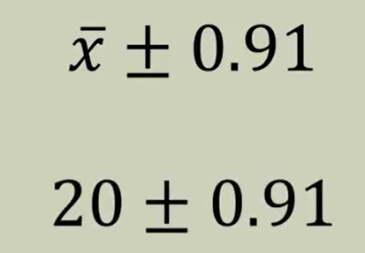
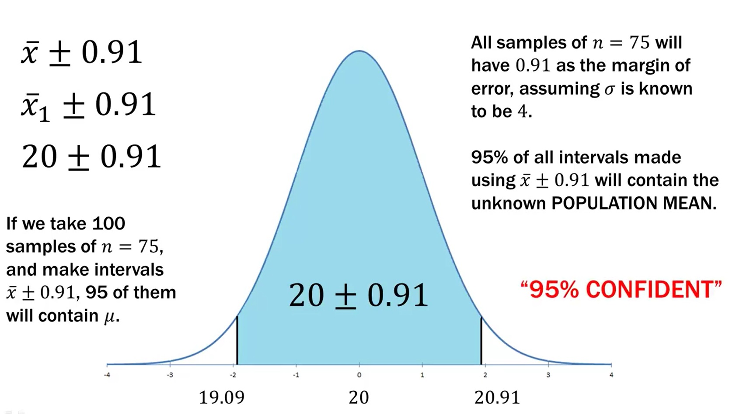
At 95% Confidence interval, what is the margin of error?
2. If the sample mean (the mean amount spent by customers) is Nu. 20, what is the 95% confidence interval for the population (population mean)?

Slide 10
Contd…

Slide 11
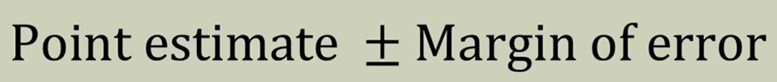
Confidence Interval: when population standard deviation is unknown
When estimating a population parameter, using a sample statistic it is never going to be perfect, there will always be error. Such error can be expressed using a interval estimate as follows:

Slide 12
Example 2
To estimate the mean amount spent per customer at a certain tea shop in Wangdue, data was collected for 15 customers. The sample standard deviation (s)was Nu. 4.
At 95% confidence, what is the margin of error?
If the sample mean is Nu. 20, what is the 95% confidence interval for the population mean?

Slide 13
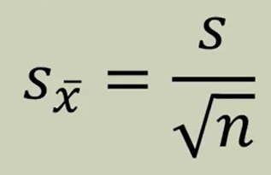
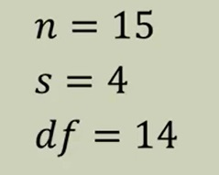
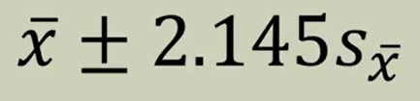
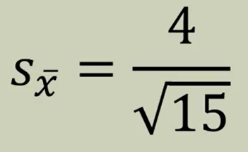
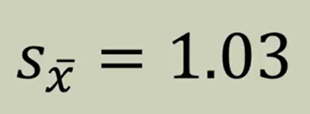
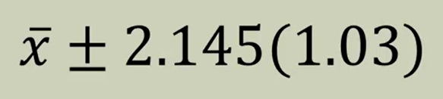
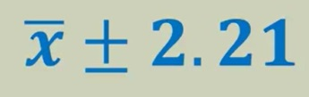
At 95% confidence, what is the margin of error?
Point estimate
Margin of error

Slide 14
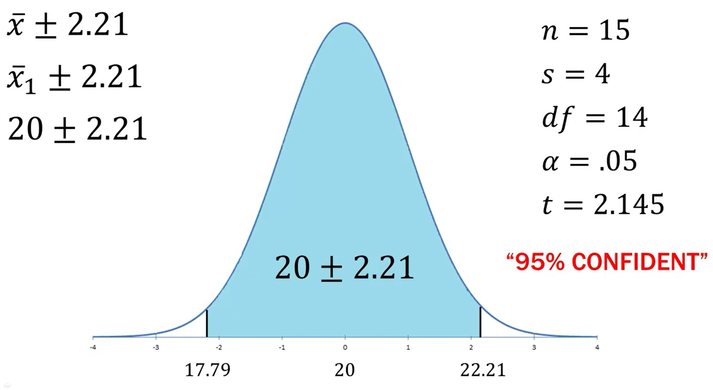
If the sample mean is Nu. 20, what is the 95% confidence interval for the population mean?

Slide 15
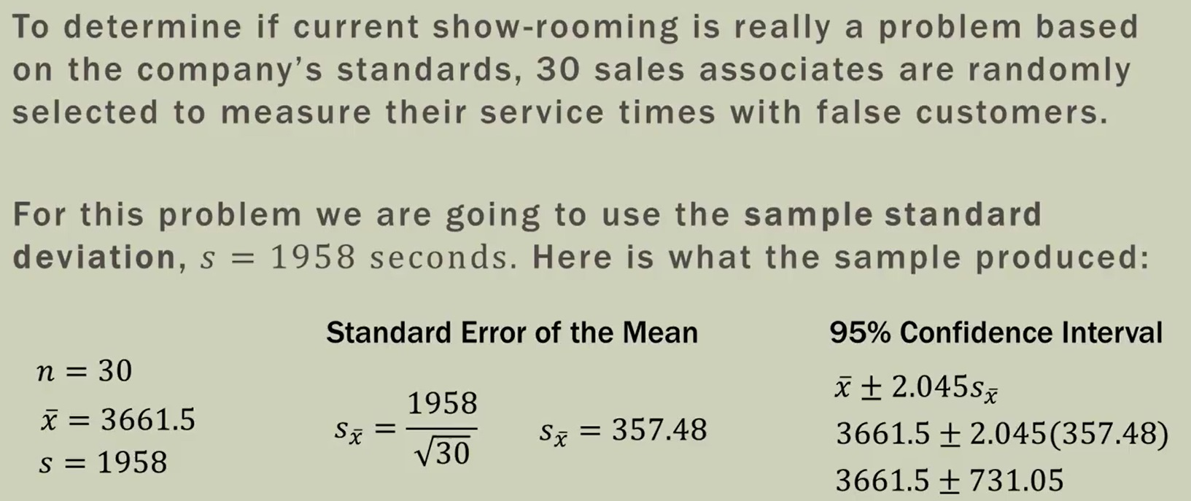
Example 3

Slide 16
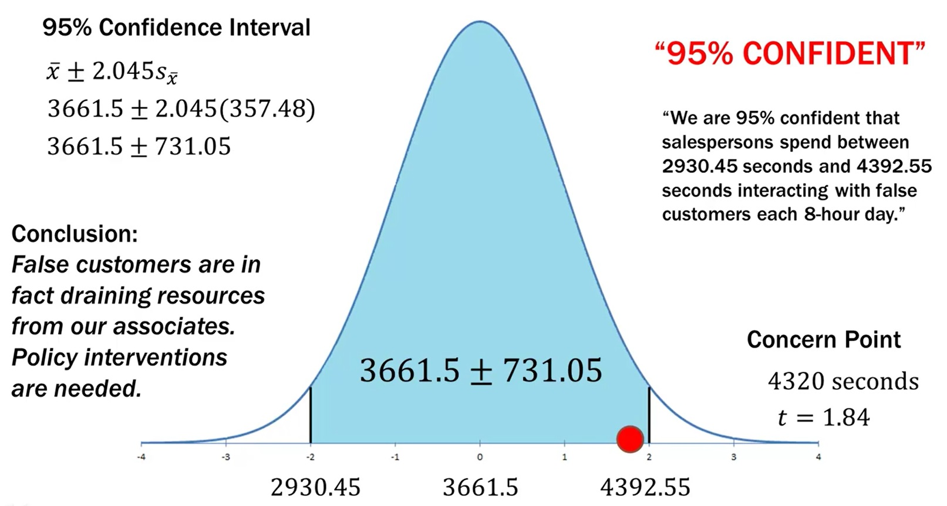

Slide 17
